Slide 1


open twin
DATA MODEL
© 2022 Open Twin
1

Slide 2
TODO
Open twin introduction Agenda
Challenges
1.1 Multi Domain and Multi Scale
1.2 Computational Resources
1.3 Data Management / Data Analytics
Open Twin
2.1 System Requirements Overview
2.2 Why Open Twin?
2.3 Architecture and Design
Open Twin Status and Research
Next Steps

Slide 3
DATA MODEL OVERVIEW
The OpenTwin data model is hierarchical and supports Model Based Systems Engineering (MBSE).
On the top level, the model describes a system composed of a collection of blocks, each of which representing a model on its own. In addition, the connectivity between the block terminals is modeled.
Each block contains information about the referenced model (e.g., specific version ID or latest version of specific branch, terminals, 3D transformation – if applicable, etc.)
block 1
block 2
block 3

Slide 4
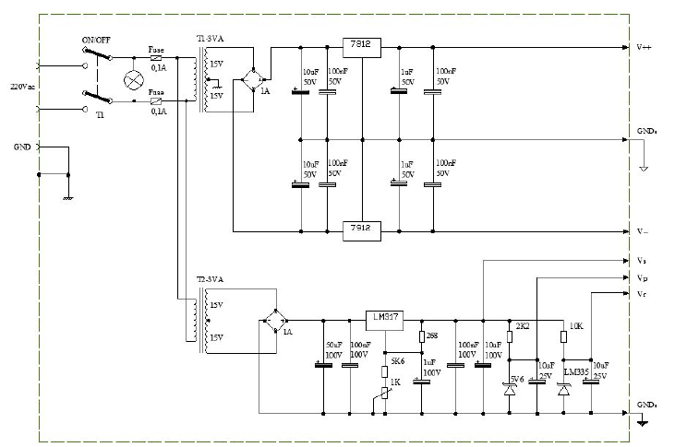
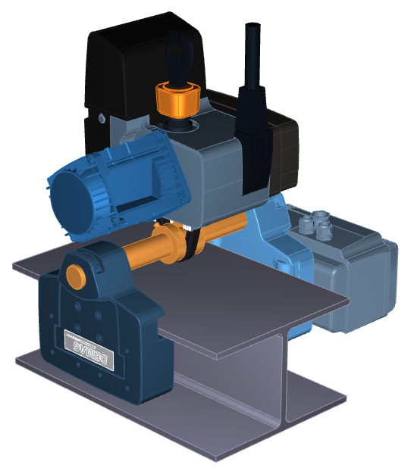
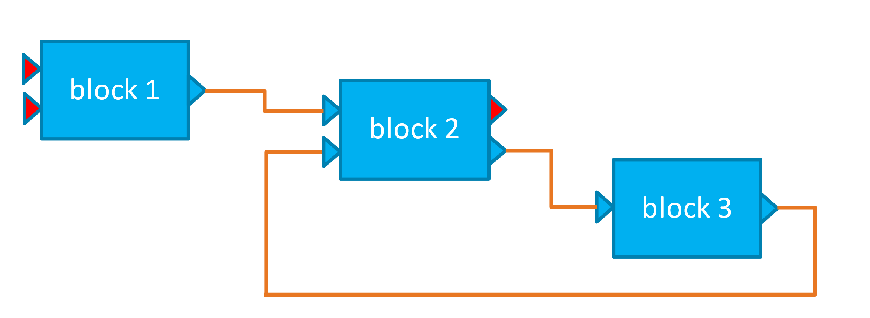
DATA MODEL OVERVIEW
Each of the blocks may represent a system model again or represents another type of model (e.g., 3D, circuit, measurement / surrogate model, etc.)
block A
block B
block C

Slide 5
open Twin Version Branches
Each model may have multiple version branches. When opening a model without specifying the version, the latest version of each branch can be displayed, and the users can decide which version of the model to open.
1.2.1.2.1
Whenever there is a branch created, .x.1 is appended to the version from which the branch is created.
x is one for the first branch, 2 for the second, and so on.
For changes in the same branch, the last version counter is incremented.
This schemes provides a unique identification for each state of the model in the version tree.
In addition, branches can optionally be labelled.
label
1.2.1.1.1
label
1.2.1
1.2.2
1.2.3
label
1.1.1
1.1.2
label
1
2
3
2.1.1
label

Slide 6
open Twin Models
Each model stores its data in a dedicated MongoDB collection. The link between the model’s name and the collection is provided by entries in a project Catalog collection.
Each project collection contains a single “model” object. The model object stores the type of the project (system, schematic, 3D, etc.).
For each version branch, a “branch” document is added to the project collection. This document contains the first and last versions of the branch as well as the currently active version of the branch. The version document can optionally contain a label for the branch. When undo / redo operations are performed in a branch, the currently active version is rolled backward and forward, respectively.
Please note that the currently active version of the branch can also be in another parent branch from which the actual branch was created (rolling back the model beyond the branching point).

Slide 7
open Twin Model states
Each version of the model is represented by a “model state” document in the project collection. The model state lists all entities which are currently part of the model at the model state’s version by their unique compound IDs.
When the model is at the end of a branch and a modification is performed, a new incremented version is created. If the branch is not at the end (e.g., due to an undo operation) and an operation is performed, the user is prompted whether a new branch shall be created or whether the subsequent versions are removed before the new version is added.
If the current position of a branch is located in a previous parent branch (e.g. due to an undo operation), deleting subsequent entries would result is deletion of other branches. Therefore, if a change is performed in a branch at this stage, a new branch must be created from this point (so the remove subsequent version option is not available then).

Slide 8
open Twin Compund Entity IDs
Compound entity ID: The compound entity ID is composed of an entity ID and a version ID. Both are unique identifiers. The separation allows to keep track of entity changes such that references to entities do not necessarily need to be updated if only the content of the entity changes (which would result in keeping the same entity but modifying the version ID).
The entity ID and the version ID are both unique IDs (UID). They must be unique but at the same time they need to be creatable in a distributed manner to avoid the bottleneck of a central management service.
A UID has a length of 8 bytes in total and is generated as follows:
36 Bits for the creation time in seconds since the year 2020
6 Bits for the ID of the session for the same project (given by the global session service)
8 Bits for the creating service ID within a session (given by the local session service)
14 Bits for a counter when creating multiple UIDs which would otherwise have the same ID (happens if the same service creates more then one UID per second)

Slide 9
open Twin Unique Identifiers
UID structure (8 bytes = 64 bits):
Limitations of UID creations:
The mechanism will not be able to create unique IDs after year 4199
The same project can be simultaneously opened up to 64 times in different sessions (the global session service needs to ensure that the session id is unique. If a session ID needs to be re-used, it needs to be ensured that at least one second has passed since the ID was previously in use)
Only up to 256 services can be part of a single session
Up to 16384 UIDs can be generated per second. If more UIDs are requested, the mechanism needs to wait for the next second until the next UID can be generated or needs to create the IDs in advance for future usage (not more than 16384 per second).
Session Counter
Service ID
Counter
Time
0 … 35
36 … 41
42 … 49
50 … 63

Slide 10
open Twin Model States
Model state objects: Model state objects can be absolute or relative:
An absolute model state object list all entities which are part of the current model version. The entities are listed by their compound ID = entity ID, version ID.
A relative model state object list the differences compared to the previous model state: One list with all entities which are added compared to the previous version and one list with all entities which are removed compared to the previous version. The relative state also contains a reference to the previous absolute state. If the actual model state needs to be written for a relative model state object, the previous absolute state need to be read and then afterward the changes of all relative model states up to the current version need to be processed incrementally.
The model state can be queried to determine the current version ID of a given entity ID.

Slide 11
open Twin Removing Versions
Removing a version: There are two main reasons why a version shall be removed:
The user decides not to create a branch after an undo operation. In this case, all subsequent versions need to be removed.
The user decides to remove an intermediate version. The intermediate version will then be removed, but all other version (before and after) remain unchanged.
When a version is removed, all entities should be removed from the data base which are only used by the removed version. This removal does not affect the functionality but reduces the size of the database. It can also be referred to as “garbage collection”. Garbage collection may also be useful in case an operation crashes before the final model state information is written. In such a situation, new entities may have already been created, but no model state (= version) refers to them.

Slide 12
open Twin Garbage Collection
Garbage Collection: The project entry in the catalog contains a flag “needs garbage collection”. This flag is set whenever a model version is removed.
In addition, the project’s version documents contain “opened” fields indicating whether the project version is currently open. When the project is closed intentionally and correctly, the opened flag is reset (see section “Locking a Version”).
A background service is running and checking frequently for all projects with the “needs garbage collection” flag turned on and the opened flag being turned off.
For these projects, the garbage collection will be started. If the project is opened in a session, the session service sends a message to the garbage collection service and the service stops the garbage collection for this project immediately.

Slide 13
open Twin Garbage Collection
Garbage Collection: When a garbage collection for the project is started, the following steps are performed:
Read all model state objects which are currently in the project and determine the compound entity IDs being referenced by them.
Iterate over all documents in the project collection, where only the compound entity ID is retrieved. Since an index is created for the compound entity ID, this operation can be performed on the index and no actual data needs to be read. For each entity, it is then checked whether the entity is referred to by any model state. If not, the entity is added to a delete list.
All entities in the delete list will be removed from the database.

Slide 14
open Twin Locking a Version
When a particular model version is opened in an editor (e.g., the 3D UI), the corresponding branch needs to be locked.
This is done by setting the current session ID as “opened” field in the version document. If the editor is closed correctly, the opened field will be set to empty.
If a version shall be opened in the editor, it needs to be checked whether the opened field contains an entry. If this is the case, a message is sent to the global session service checking whether the specified session is currently open:
If this is the case, then opening the version needs to be denied.
Otherwise, this is an indication that the project was not closed correctly and the “needs garbage collection” flag needs to be set for this project. The current session will then be set in the opened field and the specified version of the model will be opened for editing.

Slide 15
open Twin management of model states
The model state is solely managed by the “model” service. Therefore, all changes to the model state need to be communicated to the model service which will then take the necessary actions.
The services can also query the model state from the model service. This would include the list of entities contained in the current model. This query can be filtered, e.g., for entity names or entity types, etc. For example, an entity name filter can be used to query all entities which are located in a certain folder.
In addition, the model service can be queried to provide the list of current versions of a list of entities.
The model service is also able to change between different versions of a model (e.g., by specifying a particular version or via undo / redo operations). Once a new model version becomes active, the model service informs the connected user interfaces about the differential changes.

Slide 16
open Twin Creation of New Entities
Due to the concept of unique identifiers, new entities can be created by services in a distributed manner.
If an operation is performed, services can create new entities at any time and store them in the data base.
If the actual operation is completed, a new model state needs to be written such that the new entities are actually being used in the model. If an operation fails and no model state refers to the entities, these entities will be removed by the next garbage collection. If the software determines a service failure, the “needs garbage collection” flag should be set. However, having the unnecessary entities in the data base does not have a negative effect on the operation of the system (except for the unnecessary storage requirements).
The model state is solely managed by the “model” service. Therefore, all changes to the model state need to be communicated to the model service which will then take the necessary actions.

Slide 17
open Twin Creation of New Entities
The flow for creation of new entities therefore is as follows:
1. Services can create new entities with unique entity IDs and store them in the database
2. At the end of the operation, a message is sent to the model service about the new entities and the name of the new model state
3. The model service writes a new model state to the data base and notifies the connected user interfaces about potential model changes which need to be reflected in the UI.

Slide 18
open Twin Modification of Entities
xxx

Slide 19
3. open Twin TODO
TODO
Konzept topology entities und data entities
Beschreiben, wie die Veränderung von Entities (z.B. durch Properties) in Services funktioniert
Beispiele für Entities in der Datenbank -> UI
Prefetching
Large entities

Slide 20
3. open Twin status

Slide 21
3. open Twin status

Slide 22
3. open Twin status

Slide 23
3. open Twin status

Slide 24
3. open Twin status

Slide 25
3. open Twin status

Slide 26
3. open Twin status

Slide 27
3. open Twin status

Slide 28
3. open Twin status

Slide 29
3. open Twin status

Slide 30
3. open Twin status

